Slide 1

Homicide Report 1980-2014
Tensor 2.0
The Heavy

Slide 2

Agenda
Introduction
Inference
Model
Scope for Improvement
Closing Statement

Slide 3

Introduction
Problem Statement :
“Last year, an alarming increase in homicides left communities reeling as officials searched for answers. Over the past few decades, the rate at which this horrendous crime is increasing is alarming, and Governments and Police all over have been looking for insights and solutions to help them understand the situation more.”

Slide 4
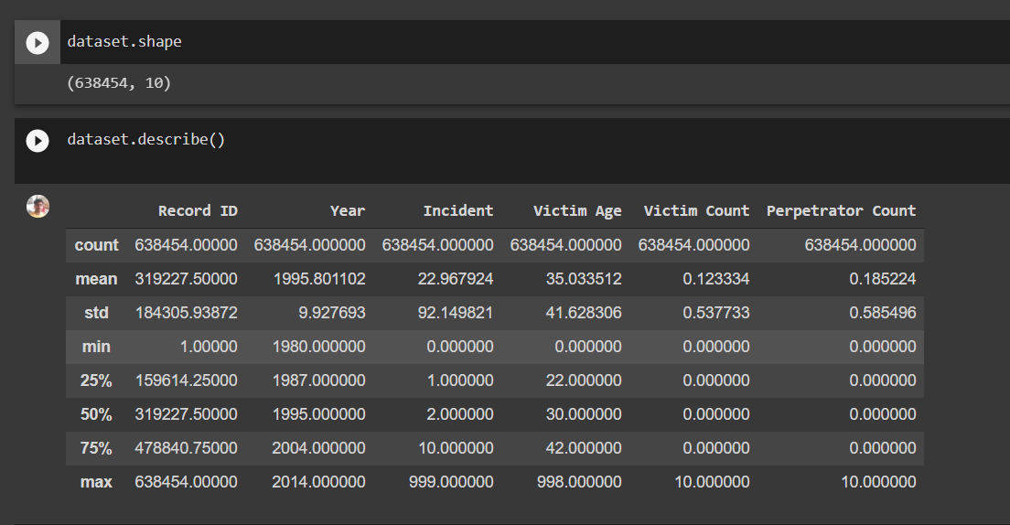
Introduction
Solution:
We used the Homicide Report 1980-2014 Dataset from Kaggle (https://www.kaggle.com/murderaccountability/homicide-reports) to understand and analyse the different cases related to homicides in the US for the years 1980-2014 and plotted necessary graphs to correlate possible features and developed an ML model to predict if a homicide case can solve or not using the given dataset.

Slide 5

Inferences from EDA
Let’s dive in

Slide 6
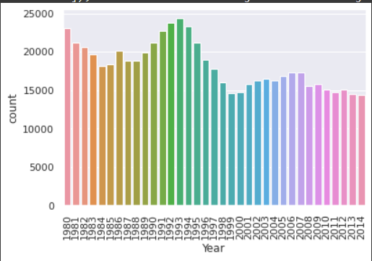
Number of Cases through the years
Peak at 1990s
Why?
Crack epidemic
Violent Crimes in the late 1980-90s
New York

Slide 7
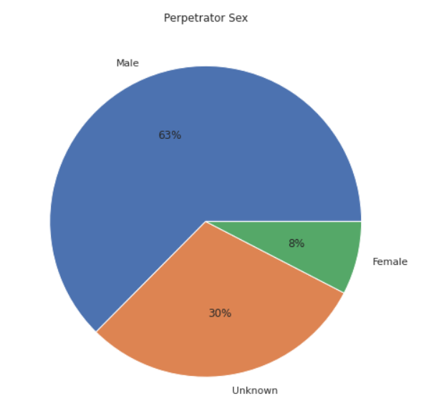
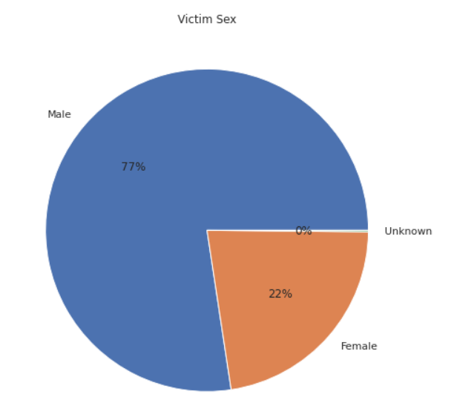
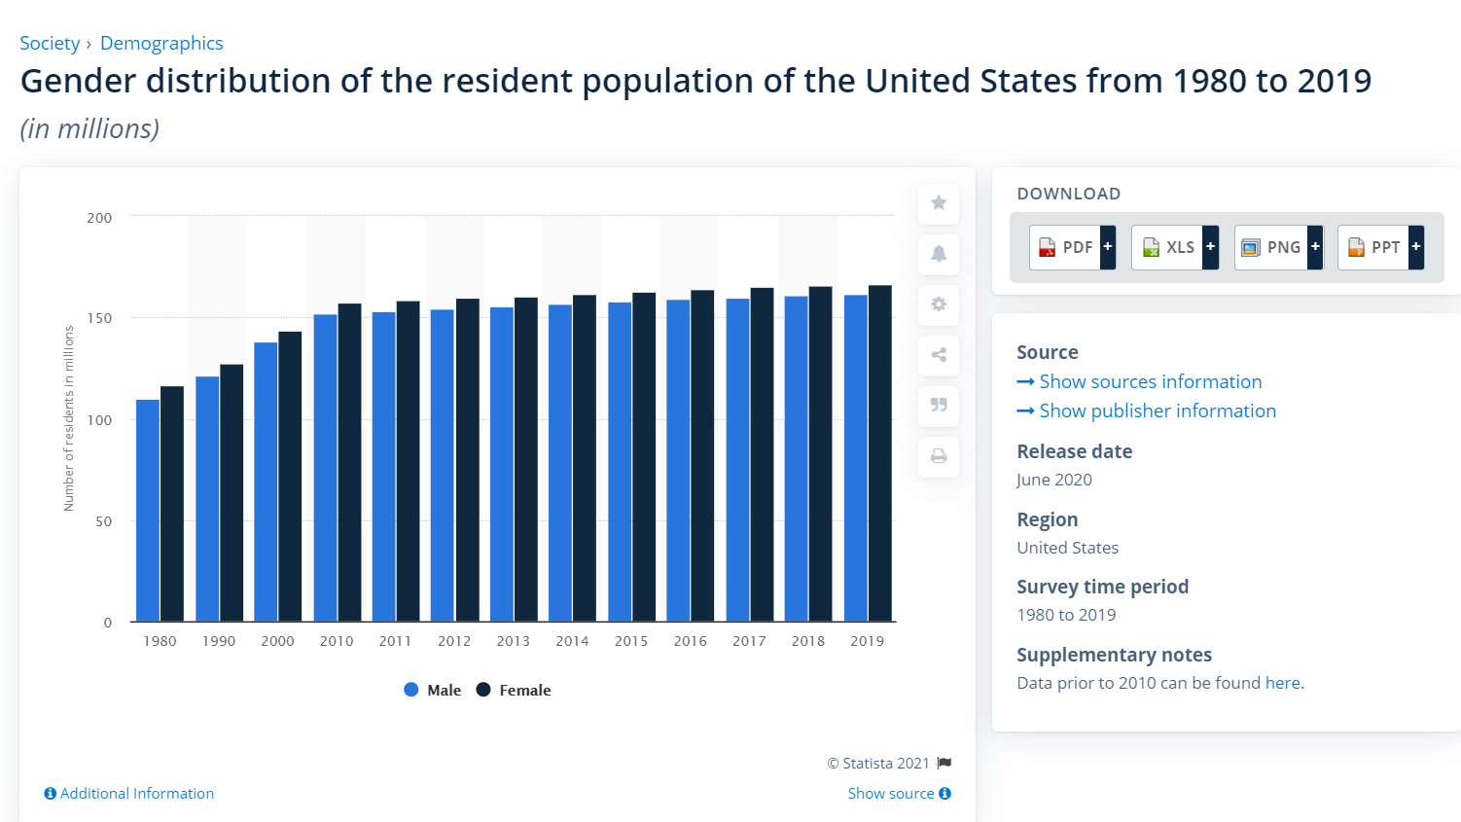
Gender Distribution
Gang related Incidents
Source: https://www.statista.com/

Slide 8
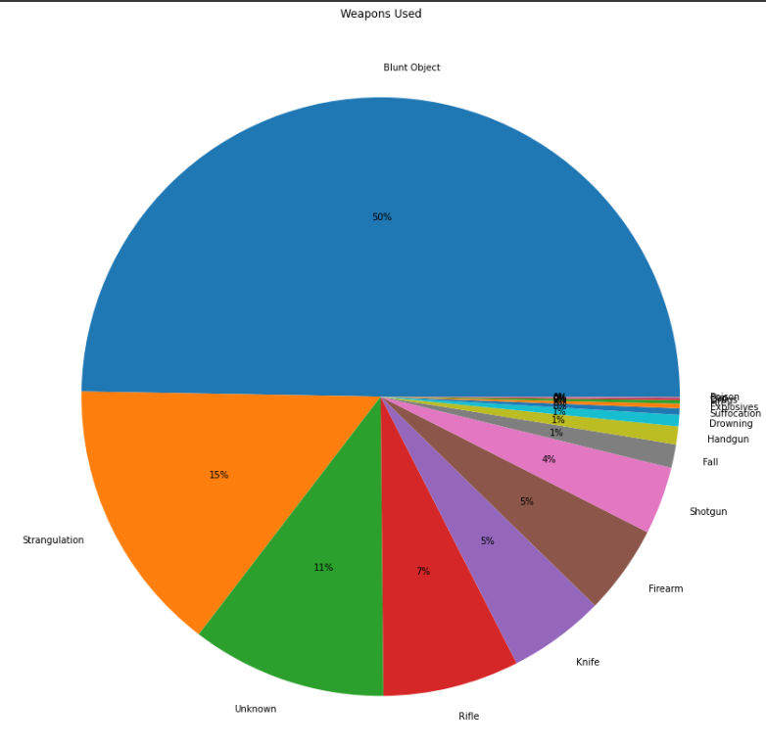
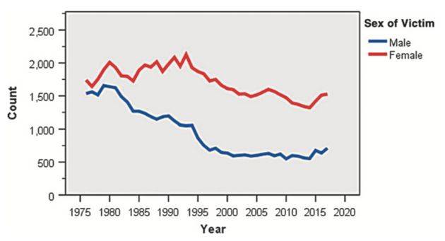
Weapon of Choice
Strangulation and Blunt Objects
Possible domestic violence or impulse decision
Source: huffpost.com

Slide 9
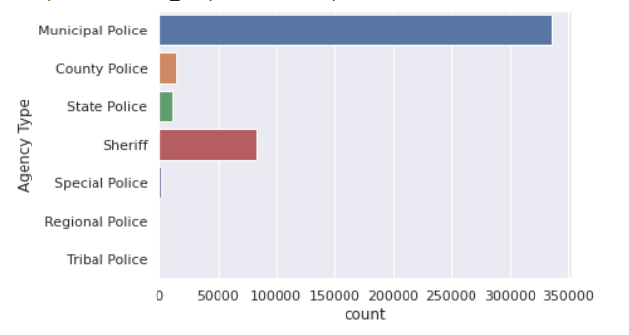
Agency Type

Slide 10

Machine Learning Model Random Forest Classifier
Its Prediction Time

Slide 11
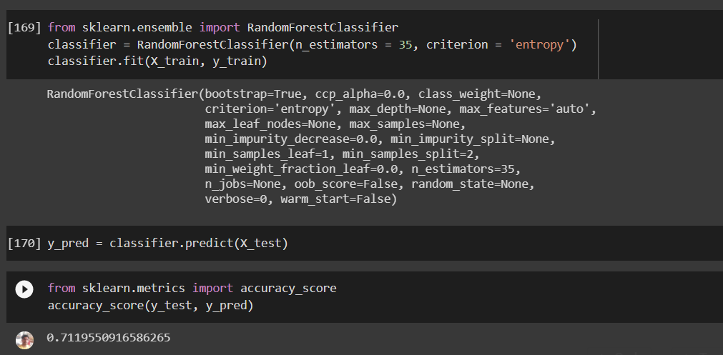
Random Forest Classifier Code
Predict if a given homicide case is solved or not?

Slide 12
Colab Demonstration

Slide 13
Scope For Improvement
Improve Accuracy
New Models
Encode more Features
Neural Networks

Slide 14

Thank You !
Team Heavy

